Slide 1
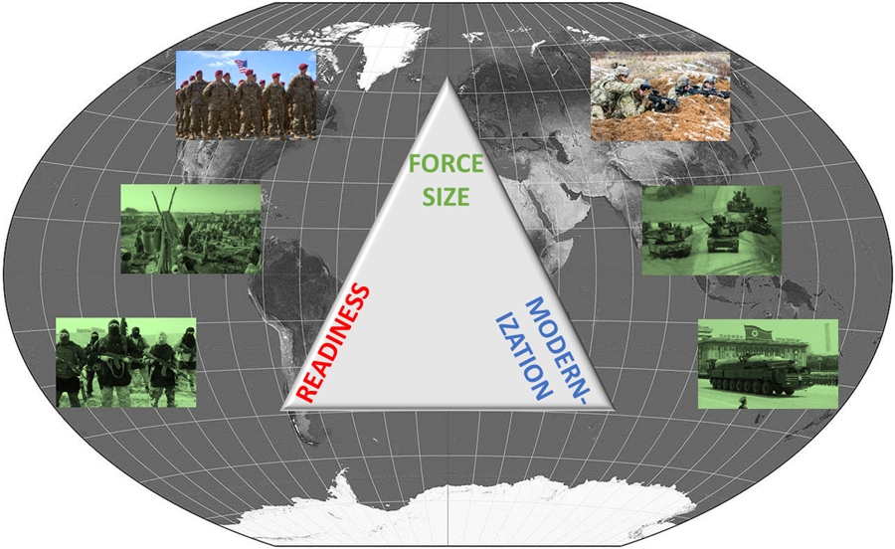



BSAP FORCE BALANCING EXERCISE
BUILD THE FORCE WARGAME

Slide 2
Purpose
To conduct a force balancing exercise that will refine appreciation for the institutional development of Army force structure
Objectives
Translate strategic policy guidance and potential future threats into Army force structure
Appreciate the complexity of developing Army force structure (trade-offs between force structure, modernization, and readiness)
Improve strategic decision-making, planning, and analysis skills
Schedule
0800-0830 | Intro/Questions
0830-1050 | Game 1
1050-1100 | Reset/Break
1100-1200 | Game 2 (speed rounds)
1200-1230 | Hotwash/AAR

Slide 3
How To Play
Game Objective: Obtain the fewest failure points
How to Win (Avoid Failure Points): Your Army’s total power (off. + def.) > crisis total power and maximize readiness funding (up to 100%)
What You Need to Decide:
Force Composition (AC/RC, qty & type)
% Readiness Funding (MILPERS, MILCON, O&M, Procurement)
Technology Level (start at 1, max = 4)
Force Upgrades (offensive, defensive, or sustainment)
How Combat (Net) Power is Calculated:
(AC + RC Total Power)*(Readiness Factor)*(Sustainment Factor)*(Technology Factor)*(Shortfall Penalty)
Game Sequence
Phase 1: Planning and Analysis
Determine Political Event
Select Research and Development
Select Readiness Funding
Select Forces
Select Force Upgrades
Phase 2: Crisis Outcome and Scoring
Roll for Capabilities and Readiness
Calculate Strength and Net Power
Determine Which Crisis Occurs
Calculate Crisis Outcome
Scoring
Notes:
https://www.csl.army.mil/BFWC/#/
https://www.csl.army.mil/BFWC/#/2

Slide 4
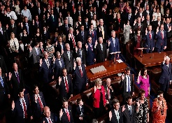
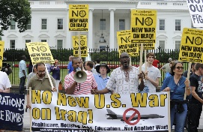
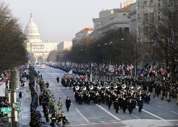

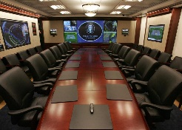
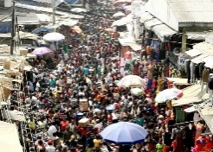
MOST LIKELY TO OCCUR
36% (Roll 2-5,10)
19% (Roll 7, 12)
14% (Roll 6)
Congressional Interests
Unfriendly Administration
Friendly Administration
Roll 2d6 to select force type and roll 1d6 for quantity (2d6 if round 3). Must procure forces ≥ quantity rolled if you don't already have them.
Decrease this round’s budget
by 10%
Increase this round’s budget
by 10%
Filling the pork barrel…
Sequestration? Again?
Friends in high places
LEAST LIKELY TO OCCUR
14% (Roll 8)
11% (Roll 9)
5% (Roll 11)
Cyber Attack
White House Priority
Uprising
Before rolling for R&D and force upgrades, roll 1d6 to determine reduction to force upgrade rolls this round
Roll 2d6 to select crisis using crisis board. Must exceed the priority force requirements by at least 2 units of either type.
Roll 1d6 before crisis outcome roll. If ≥ 5, increase crisis outcome roll by 2. If 2 ≤, decrease crisis outcome roll by 2.
Those cheaters…
Someone’s got their attention
Will they love us or hate us?

Slide 5


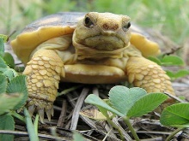
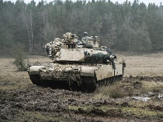
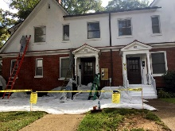
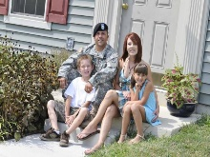
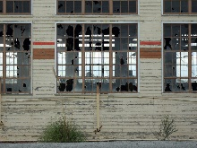
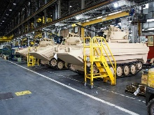
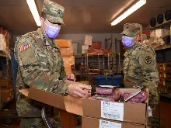
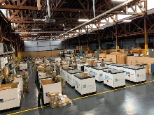
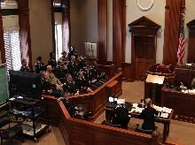
MOST LIKELY TO OCCUR
36% (Roll 2-5,10)
19% (Roll 7, 12)
14% (Roll 6)
Public Opinion
Training Environment
Health and Quality of Life
Roll 1d6 for (effect) on MILPERS
Roll 1d6 for (effect) on O&M
Roll 1d6 for (effect) on
MILPERS & MILCON
1 (-2), 2-3 (-1)
Anti-Military Sentiment
4-5 (+1), 6 (+2)
Pro-Military Sentiment
1 (-2),2-3 (-1)
Restrictive
4-5 (+1), 6(+2)
Permissive
1 (-2),2-3 (-1)
Low
4-5 (+1), 6(+2)
High
Do they love us or hate us?
Train like we fight?
Happy and healthy or not?
LEAST LIKELY TO OCCUR
14% (Roll 8)
11% (Roll 9)
5% (Roll 11)
Infrastructure
Supply Chain
Corruption and Scandals
Roll 1d6 for (effect) on MILCON
Roll 1d6 for (effect) on
Procurement & O&M
Roll 1d6 for effect and type
Effect
1-2: -1
3-4: -2
5-6: -3
Type
1: MILCON
2: MILPERS
3: Procurement
4: O&M
5: All
6: No effect
1 (-2), 2-3 (-1)
Inadequate performance
4-5 (+1), 6 (+2)
Successful Performance
1 (-2),2-3 (-1)
Inadequate Performance
4-5 (+1), 6(+2)
Successful Performance
Keeping the lights on…
Are you the weakest link?
The Army’s bad apples…

Slide 6
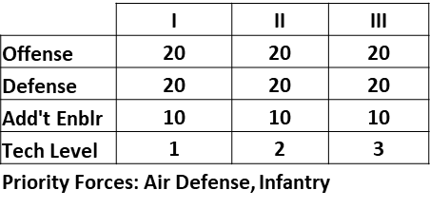
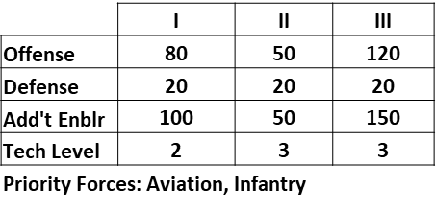
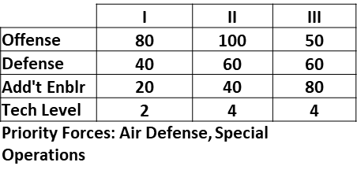
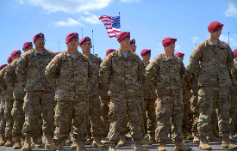
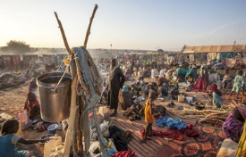
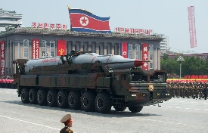
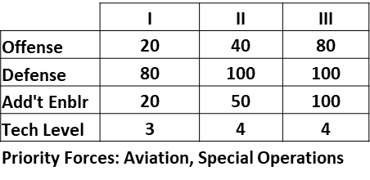
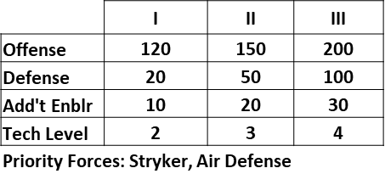
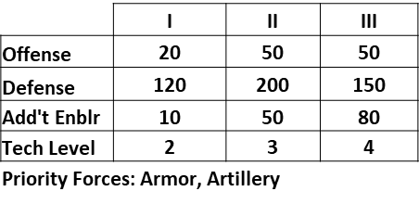
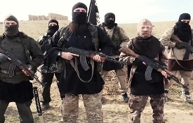
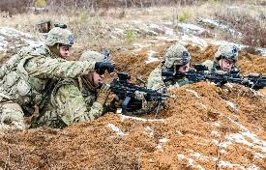
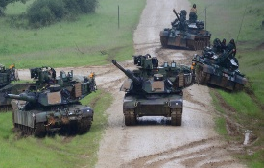
MOST LIKELY TO OCCUR
36% (Roll 2-5,10)
19% (Roll 7, 12)
14% (Roll 6)
Steady State
Humanitarian Crisis
Rogue State
LEAST LIKELY TO OCCUR
14% (Roll 8)
11% (Roll 9)
5% (Roll 11)
ISIS 2.0
Defensive Campaign
(vs Peer Competitor)
Offensive Campaign
(vs Peer Competitor)

Slide 7
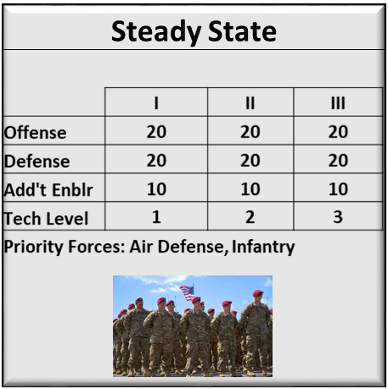
Example of Net Power Calculation and Scoring
Roll for Political Event (Unfriendly Administration, -10% to budget)
Select Tech Level 2, Risk Level 2
Fund readiness for all categories at 100%
Procure 2 RC infantry, 10 AC armor, 1 AC air defense, 11 RC enablers
Upgrade armor offense and defense
Roll 4 for R&D (no need for re-roll $$)
Roll for readiness events (public opinion, 3 = -1 to MILPERS & Training Environment, 5 = +1 to O&M) and rolls (8, 3(-1), 7(+1), 10)
Roll 5 for Force Upgrades (Upgrade at overrun cost)
Roll 10 for RC capability factor
“Steady State” crisis occurs (roll of 5), meet priority force req’mt [have 2 infantry and 1 air defense]
Roll 7 for crisis outcome
Loss value = 1.2. [No need to lose forces in round 2 since crisis was steady state and loss value < 8]
Reset for Round 2: Note that any unspent resources do not carry over
(Factor Min-Max)
(0-1)
(0-1)
(0.66-1.33)
(1 or 0.50)
(AC + Adj. RC Total Power)*(Readiness Factor)*(Sustainment Factor)*(Technology Factor)*(Shortfall Penalty)
[172.3]*
[1]
[0.73]
[1.15]
[1]
*with RC Capability Factor = [0.90]
[Net Power = 144.5]

Slide 8
Key Rules (1 of 2)
Resource Limit applies for each round (shown at top of calculator). Any unused resources do not carry over.
R&D allows you to advance technology levels (start at 1, highest = 4). If you fail, you may retry (re-roll) one time at additional cost. Tech levels improve your odds of winning crises and enable force upgrades. Expedited R&D advances 2 levels at 2x cost at min risk level 3.
Force Upgrades: you may NOT reroll if you fail, must cancel or pay overrun costs (+ 50%). R&D reduces upgrade risk. More upgrades (larger modernization programs) reduces cost but increases risk. R&D and Force Upgrades carry over into next round.
RC Forces have 70% lower O&M cost, but risk lower performance (2d6 roll for RC Capability Factor which also affects RC enabler reqmt)
Force Upgrade Example
6 units x 1 type upgrade = 6x cost
2 units x 3 upgrades = 6x cost
4 types of upgrades = cost 5/upgrade

Slide 9
Key Rules (2 of 2)
1 enabler force meets 10 enabler requirement
1 AVN provides + 1 def., 1 ARTY provides +1 off. to 1 ARM, INF, or STR
Crisis Power Cards
Off, Def, & Tech Level = crisis/adversary capabilities
Add’t Enablers = Army support to other Services or external organizations (e.g. humanitarian assistance)
To avoid shortfall penalty (50% reduction in power), Priority Force QTY must be ≥ round number + crisis tech level & have min 1 of each force type (e.g. for Steady State Round 2, min 4 air defense and/or infantry)
Round Numbers
Crisis/Threat Capabilities
Scoring
Reference readiness and crisis outcome tables (failure to meet requirements/minimum roll = failure points)
Losses: in each crisis, you will lose forces equal to (your Army’s net strength/crisis total strength)*crisis total strength. Ignore any losses for the Steady State crisis, all others you must lose at least 1 force.

Slide 10
Crisis Board Links
https://www.csl.army.mil/BFWC/#/
https://www.csl.army.mil/BFWC/#/2
https://www.csl.army.mil/BFWC/#/3

